Slide 1
Bayesian Estimation of Negative Binomial Regression
Zachary Kiefer

Slide 2
The Negative Binomial Distribution
Consider a simple experiment which has probability of success p, and which is repeated until it has failed r times.
The negative binomial distribution NB(r, p) measures the probability of observing some number of successes k before the rth failure.
This makes the negative binomial distribution useful for modeling “time-to-failure” or “time-to-event” data.
E.g. the amount of time someone chooses to remain unemployed before deciding to leave the labor force.
The NB distribution is also useful as an alternative to the Poisson distribution, since it relaxes the restriction, made under Poisson, that the mean be equal to the variance.
Notes:
Other example: the number of times a paper is rejected from a journal before being accepted for publication.
Poisson is limiting case of NB distribution.

Slide 3
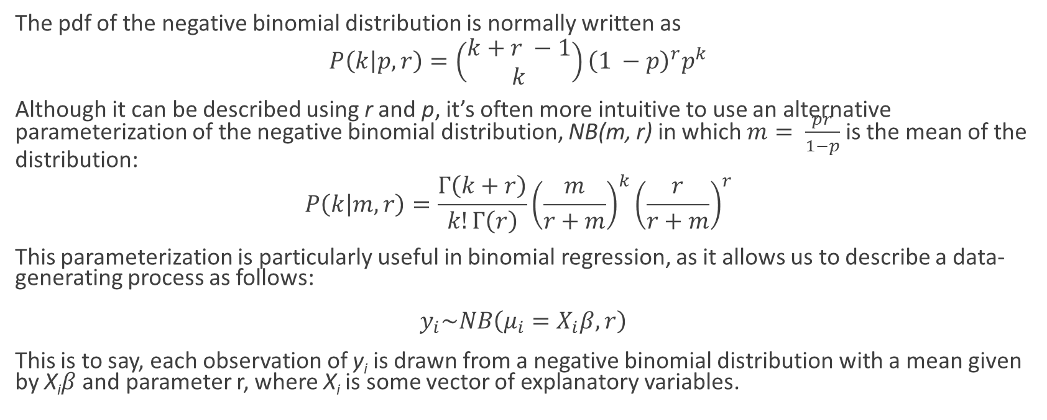
Alternative Parameterization
The pdf of the negative binomial distribution is normally written as
$$P\left(k | p, r\right)=\left(\begin{matrix}k+r −1 \\ k\end{matrix}\right){\left(1 −p\right)}^{r}p^{k}$$
Although it can be described using r and p, it’s often more intuitive to use an alternative parameterization of the negative binomial distribution, NB(m, r) in which $m= \frac{pr}{1−p}$ is the mean of the distribution:
$$P\left(k | m,r\right)=\frac{Γ\left(k+r\right)}{k!Γ\left(r\right)}{\left(\frac{m}{r+m}\right)}^{k}{\left(\frac{r}{r+m}\right)}^{r}$$
This parameterization is particularly useful in binomial regression, as it allows us to describe a data-generating process as follows:
$y_{i}\sim NB\left(μ_{i}=X_{i}β, r\right)$
This is to say, each observation of y_{i} is drawn from a negative binomial distribution with a mean given by X_{i}$β$and parameter r, where X_{i} is some vector of explanatory variables.
Notes:
By analogy, each observation in an OLS regression is drawn from a normal distribution with a mean given by X_i Beta.

Slide 4

Bayesian Model
If we want to estimate this model in a Bayesian framework, there will be two objects of interest:
$β$, a vector of coefficients attached to our explanatory variables, and
r, the number of failures.
r can also be interpreted as a “dispersion parameter” governing the variance of the distribution.
We will estimate this model using the Metropolis-Hastings algorithm.
Notes:
Again, the negative binomial is a special case of the poisson distribution, and is sometimes referred to as an “overdispersed Poisson”. That r parameter governs just how overdispersed it is.

Slide 5
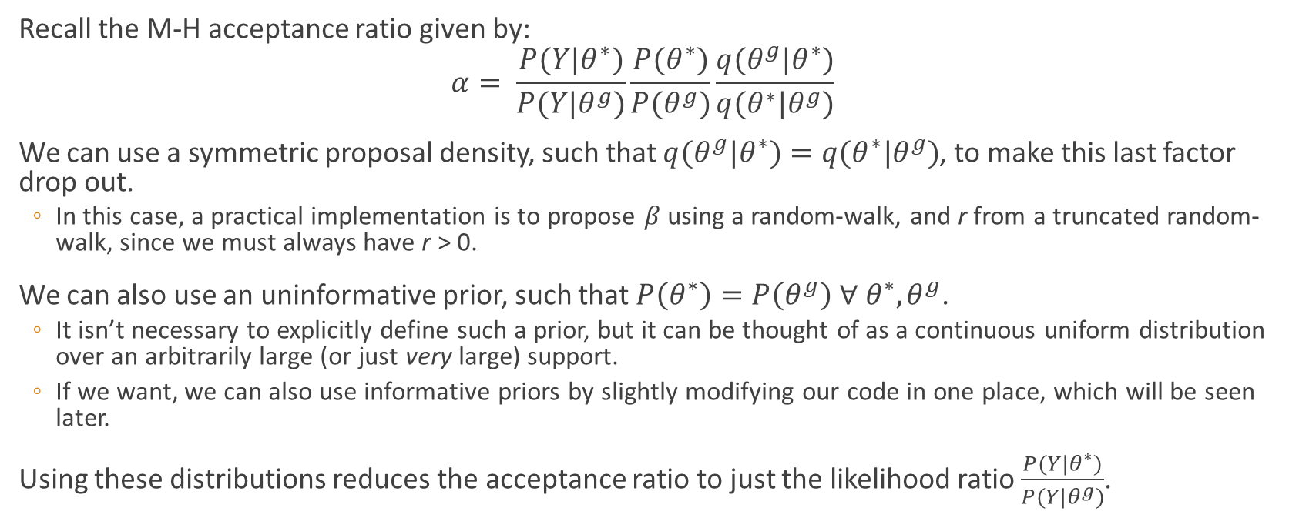
Metropolis-Hastings Acceptance Ratio
Recall the M-H acceptance ratio given by:
$$α= \frac{P(Y|θ^{∗})}{P(Y|θ^{g})}\frac{P(θ^{∗})}{P(θ^{g})}\frac{q(θ^{g}|θ^{∗})}{q(θ^{∗}|θ^{g})}$$
We can use a symmetric proposal density, such that $q(θ^{g}|θ^{∗})=q(θ^{∗}|θ^{g})$, to make this last factor drop out.
In this case, a practical implementation is to propose $β$ using a random-walk, and r from a truncated random-walk, since we must always have r > 0.
We can also use an uninformative prior, such that $P\left(θ^{∗}\right)=P\left(θ^{g}\right) ∀ θ^{∗}, θ^{g}$.
It isn’t necessary to explicitly define such a prior, but it can be thought of as a continuous uniform distribution over an arbitrarily large (or just very large) support.
If we want, we can also use informative priors by slightly modifying our code in one place, which will be seen later.
Using these distributions reduces the acceptance ratio to just the likelihood ratio $\frac{P(Y|θ^{∗})}{P(Y|θ^{g})}$.
Notes:
Truncated Random-Walk: draw r* from a normal distribution centered on r^g but left-truncated at 0.
We don’t have any real restrictions on the betas, but we DO need to have all of the mus be greater than 0. Thankfully, the likelihood gets very close to 0 if mu becomes too small, which makes it unlikely that we accept draws of theta which bring mu close to 0.

Slide 6
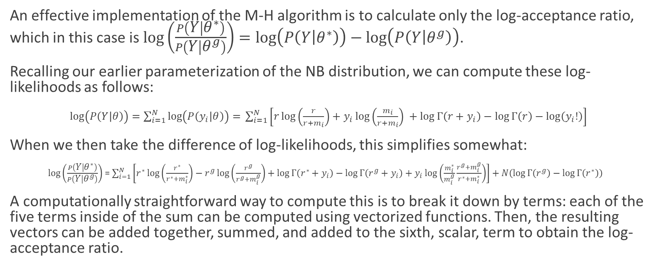
Computing the Log-Likelihood Ratio
An effective implementation of the M-H algorithm is to calculate only the log-acceptance ratio, which in this case is $\log\left(\frac{P\left(Y | θ^{∗}\right)}{P\left(Y | θ^{g}\right)}\right)=\log\left(P\left(Y | θ^{∗}\right)\right)−\log\left(P\left(Y | θ^{g}\right)\right)$.
Recalling our earlier parameterization of the NB distribution, we can compute these log-likelihoods as follows:
$\log\left(P\left(Y | θ\right)\right)=\sum_{i=1}^{N}{\log\left(P\left(y_{i} | θ\right)\right)= }\sum_{i=1}^{N}{\left[r\log\left(\frac{r}{r+m_{i}}\right)+y_{i}\log\left(\frac{m_{i}}{r+m_{i}}\right) +\log{Γ\left(r+y_{i}\right)−\log{Γ\left(r\right)}}−\log\left(y_{i}!\right)\right]}$
When we then take the difference of log-likelihoods, this simplifies somewhat:
$\log\left(\frac{P\left(Y | θ^{∗}\right)}{P\left(Y | θ^{g}\right)}\right)$ = $\sum_{i=1}^{N}{\left[r^{∗}\log\left(\frac{r^{∗}}{r^{∗}+m_{i}^{∗}}\right)−r^{g}\log\left(\frac{r^{g}}{r^{g}+m_{i}^{g}}\right)+\log{Γ\left(r^{∗}+y_{i}\right)−\log{Γ\left(r^{g}+y_{i}\right)}+y_{i}\log\left(\frac{m_{i}^{∗}}{m_{i}^{g}}\frac{r^{g}+m_{i}^{g}}{r^{∗}+m_{i}^{∗}}\right)}\right]}+N\left(\log{Γ\left(r^{g}\right)}−\log{Γ\left(r^{∗}\right)}\right)$
A computationally straightforward way to compute this is to break it down by terms: each of the five terms inside of the sum can be computed using vectorized functions. Then, the resulting vectors can be added together, summed, and added to the sixth, scalar, term to obtain the log-acceptance ratio.

